Slide 3

Dark mode

Slide 4
Bright mode

Slide 5
Dark mode

Slide 6
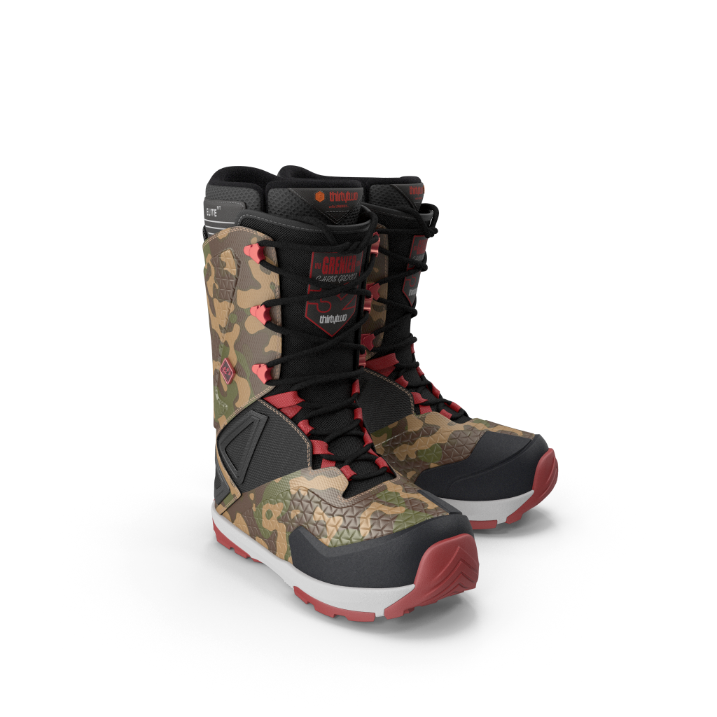
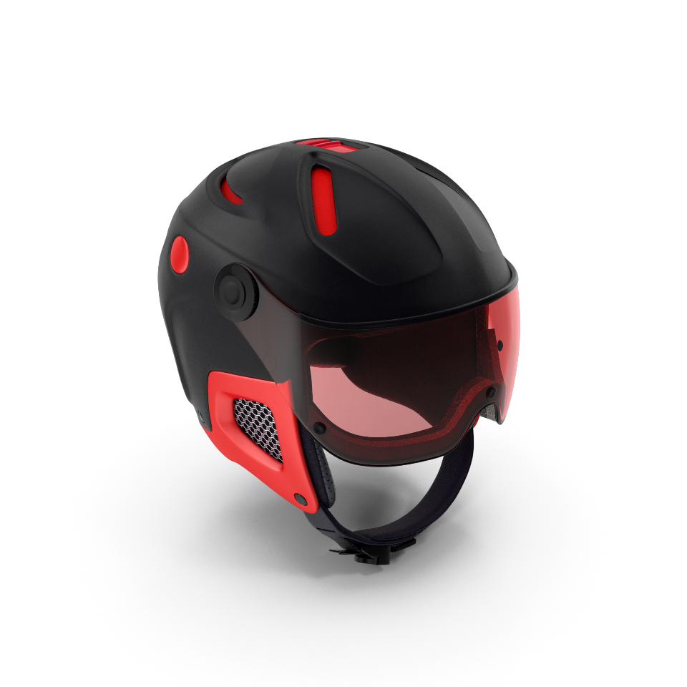
V2_Helmet
Snboots_V3
Adjustable ventilation
Multi-Impact foam
Durable shell
Be ready
For the
Ride .

Slide 7
V2_Helmet
Snboots_V3
Adjustable ventilation
Multi-Impact foam
Be ready
For the
Ride .
Durable shell

